Slide 1

UCF
2023-24 Data Competition

Slide 2
Addition Financial
Founded in 1937 | Member-owned | Not-for-profit
Formerly known as CFE to Addition Financial on May 1, 2019
Roots and heritage tied to education in Central Florida
Profits go back to the member in the form of higher dividends and lower loan rates
Full suite of financial products & services

Slide 3
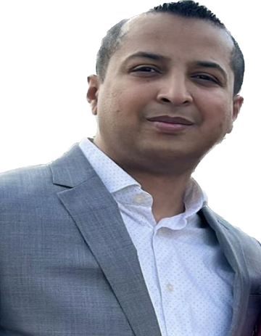
Sital Nayee, CSD
Business Intelligence Team (AFCU)
Associate Systems Analyst
10+ Years of Experience with Addition Financial
B.Sc. Degree in Information Systems and Data Analytics
Data Analysis, Data Exploration, Data Manipulation, and Data Mining
Developing ML Models, Report Generation, Data Visualization and Statistical Analysis
Tools : R, Python, SQL and Power BI

Slide 4
Competition Overview

Slide 5
The Problem
This problem statement aims to address the challenge of enhancing our branch location selection process to align with changing market dynamics, customer behaviors, and emerging trends in the financial sector.

Slide 6
Dataset(s)
Branch Level Data Set
This dataset will provide students with count of transactions for every single branch by transaction type as of End of Month from the Year 2022 till End of Month July 2023.
Member Level Data Set
This dataset will provide students with count of transactions by transaction type for members as of End of Month for the Year 2022 till End of Month July 2023.

Slide 7
Process
UCF students would be given data on where Addition Financial is eligible to build branches within the State of Florida.
The students would then have free reign to use publicly available data sources to gather demographic and location data to make an educated decision about where the next Addition Financial branch should be built.

Slide 8
Primary Objective
The primary objective is to predict, with a high degree of accuracy, and make a well-informed decision(s) about the most promising location(s) for Addition Financials’ next expansion.

Slide 9
Deliverables
All entries will be judged based on the following criteria:
• Content in the Project Report
• Modeling Approach
• Results and Conclusions
• Presentation of results

Slide 10
Eligibility
• Full-time, Part-time UCF students and Graduating students
• Teams may not be larger than 5 people
• Employees, immediate family members of employees, and/or those living in the same household as employees of Addition Financial Credit Union are not eligible.

Slide 11
Prizes
FIRST PLACE
$3,000
SECOND PLACE
$1,500
THIRD PLACE
$500

Slide 12
Important Dates

Slide 13
Important Dates
September 22nd, 2023
Competition Commences
January 15th, 2024
Documents/Files Due
Link for uploading submissions is also available on
https://sciences.ucf.edu/statistics/addition-financial-competition-2023-24/

Slide 14
Important Dates
February 6th, 2024 through February 17th, 2024
All Presentations will be held at Addition Financial HQ
March 1st, 2024
AFCU notifies UCF Department of Statistics and Data Science of winners
March 14th, 2024
**Winning Teams will be required to formally present their findings at the Big Data Analytics Symposium 2024 at the UCF Main Campus, Pegasus Ballroom**

Slide 15
Tips
Utilize a wide range of publicly available sources such as Census data, city and county websites, and various governmental statistics ( Please remember to reference your sources in APA Format )
Research and mine your data to gain valuable insights into the diverse communities and neighborhoods across Florida.
Please refer to Data Dictionary Description tables to seek information about our Community Charter, Visit our Website to gain more information about our Branch Locations, try and convert data and gain meaningful insights from the datasets we have provided.
Throughout the process, participants will have the opportunity to collaborate with industry experts, receive guidance from either their professor’s and or Graduate Assistants, and present their findings.

Slide 16
Q & A
Thank you for joining us today and we wish you all the best throughout the Competition !!
Dept-BusinessIntelligence@additionfi.com

